Slide 1
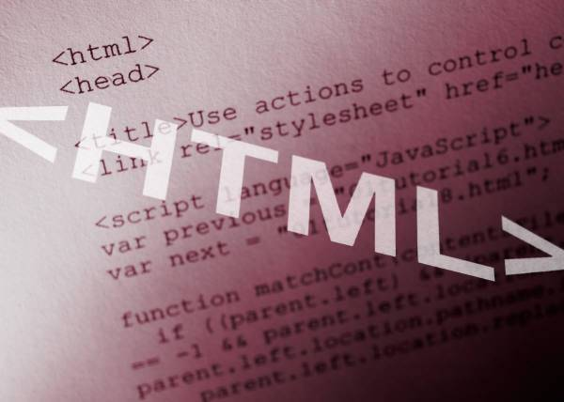


HTML 5
The past, the present, the future
Telerik Software Academy
Learning & Development Team
http://academy.telerik.com

Slide 2

Table of Contents
Hypertext Markup Language
HTML Concepts
HTML Document Structure
HTML Common Elements
Section Elements
Semantic Structural Tags

Slide 3
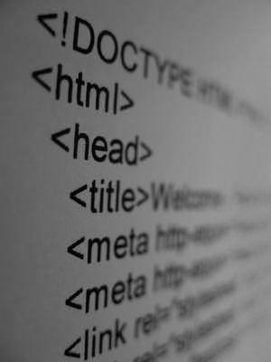
Hypertext Markup Language

Slide 4
Hypertext Markup Language
HTML – Hyper Text Markup Language
A notation for describing
document structure (semantic markup)
formatting (presentation markup)
Looks (looked?) like:
A Microsoft Word document
The markup tags provide information about the page content structure
A HTML document consists of many tags

Slide 5
Creating HTML Pages
An HTML document must have an .htm or .html file extension
HTML files can be created with text editors:
Notepad, Notepad++, Sublime Text
Or HTML editors (WYSIWYG Editors):
Microsoft WebMatrix
Microsoft Expression Web
Microsoft Visual Studio
Adobe Dreamweaver

Slide 6

HTML – Past, Present, Future
1991 – HTML first mentioned – Tim Berners-Lee – HTML tags
1993 – HTML (first public version, published at IETF)
1993 – HTML 2 draft
1995 – HTML 2 – W3C
1995 – HTML 3 draft
1997 – HTML 3.2 – “Wilbur”
1997 – HTML 4 – ”Cougar” – CSS
1999 – HTML 4.01 (final)
2000 – XHTML draft
2001 – XHTML (final)
2008 – HTML5 / XHTML5 draft
2011 – feature complete HTML5
http://en.wikipedia.org/wiki/HTML5#Plan_2014

Slide 7


HTML Terminology
Tags, Attributes and Elements

Slide 8
HTML Terminology
Concepts in HTML
Tags
Opening tag and closing tag
The smallest piece in HTML
Attributes
Properties of the tag
Size, color, etc…
Elements
Combination of opening, closing tag and attributes

Slide 9
HTML Tags
Tags are the smallest piece in HTML Document
Start with "<" and end with ">"
Two kinds of tags
Opening
Mark the start of an HTML element
Closing
Mark the end of an HTML element
Start in "</"
Opening tag
Opening tag
Opening tag
<html>
<body>
<h1>Hello Pesho!</h1>
</body>
</html>
Closing tag
Closing tag
Closing tag

Slide 10
Attributes
Attributes are properties of HTML Elements
Used to set size, color, border, etc…
Put directly in the tags
Has value surrounded by " " or ' '
The value is always a string
<!-– makes a hyperlink to Google -->
<a href="http://google.com"> go to Google</a>
<!-– makes a horizontal line -->
<hr width="95%" size="3px"/>
<!-– adds an image in the web page -->
<img src="images/SEB-Ninja.png"/>
Some tags don't have closing tag
Some tags don't have closing tag

Slide 11
Most Common Attributes
There are some attributes that are common for every HTML element
Id, class, name, style
And some attributes are specific
For example the attribute src of the img element
Shows the path to the image to be shown

Slide 12
HTML Elements
HTML Elements are combination of tags and attributes
Opening tag with some or none attributes and a closing tag
<a href="http://google.com"> go to Google</a>
<html>…</html>

Slide 13


HTML Terminology
Live Demo

Slide 14
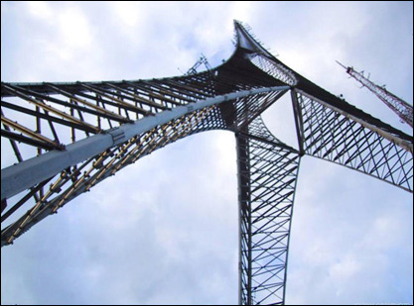

HTML Document Structure
HTML Document, Doctype, Head, Body

Slide 15
HTML Document Structure
Some elements are essential to each HTML Document:
html, head, body, doctype
The html element
Used to mark the beginning and ending of a HTML document
All the content of the web page is inside this tag
<html>
…
</html>

Slide 16
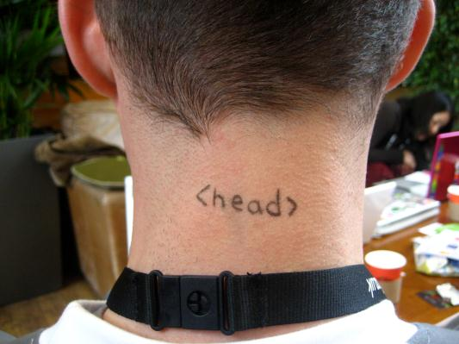
Head Element
The head tag contains markup that is not visible to the user (i.e. the person using the browser)
But helps the browser to render correctly the HTML document
What is in there?
Styles, scripts
Declare encodings
Etc..
The title tag - the text in the tab of a browser

Slide 17
Body Element and Doctype
body element contains all the visible to the user markup
Headings, text, hyperlinks, images, etc…
Textboxes, sliders, buttons…
Doctype is kind of the validator of the page
Tells the browser in which version of HTML the page is written
HTML 5 Doctype
<!DOCTYPE html>

Slide 18
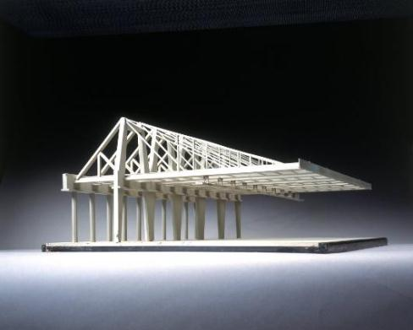

HTML Document Structure
Live Demo

Slide 19
HTML Common Elements
Used in 90% of all the sites

Slide 20
Text Formatting
Text formatting tags modify the text between the opening tag and the closing tag
Ex. <b>Hello</b> makes "Hello" bold
<b></b> | bold
<i></i> | italicized
<u></u> | underlined
<sup></sup> | Sample^{superscript}
<sub></sub> | Sample_{subscript}
<strong></strong> | strong
<em></em> | emphasized
<pre></pre> | Preformatted text
Many of the formatting tags are deprecated
Use CSS instead
20

Slide 21
Some Simple Tags
Hyperlink Tags
Image Tags
Text formatting tags
<a href="http://www.telerik.com/"
title="Telerik">Link to Telerik Web site</a>
<img src="logo.gif" alt="logo" />
This text is <em>emphasized.</em>
<br />new line<br />
This one is <strong>more emphasized.</strong>

Slide 22
Headings and Paragraphs
Heading Tags (h1 – h6)
Paragraph Tags
Sections: div and span
<h1>Heading 1</h1>
<h2>Sub heading 2</h2>
<h3>Sub heading 3</h3>
<p>This is my first paragraph</p>
<p>This is my second paragraph</p>
<div style="background: skyblue;">
This is a div</div>

Slide 23
Ordered Lists: <ol> Tag
Create an Ordered List using <ol></ol>:
Attribute values for type are 1, A, a, I, or i
<ol type="1">
<li>Apple</li>
<li>Orange</li>
<li>Grapefruit</li>
</ol>
Apple
Orange
Grapefruit
Apple
Orange
Grapefruit
Apple
Orange
Grapefruit
Apple
Orange
Grapefruit
Apple
Orange
Grapefruit

Slide 24
Unordered Lists: <ul> Tag
Create an Unordered List using <ul></ul>:
Attribute values for type are:
disc, circle or square
<ul type="disc">
<li>Apple</li>
<li>Orange</li>
<li>Grapefruit</li>
</ul>
Apple
Orange
Pear
Apple
Orange
Pear
Apple
Orange
Pear

Slide 25
Definition lists: <dl> tag
Create definition lists using <dl>
Pairs of text and associated definition; text is in <dt> tag, definition in <dd> tag
Renders without bullets
Definition is indented
<dl>
<dt>HTML</dt>
<dd>A markup language …</dd>
<dt>CSS</dt>
<dd>Language used to …</dd>
</dl>

Slide 26
HTML Common Elements
Live Demo

Slide 27
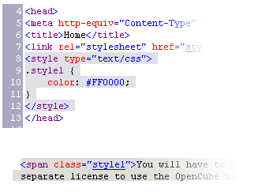

Section Elements
The <div> and The <span>

Slide 28
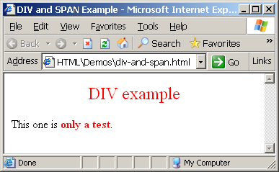
The <div> Tag
<div> creates logical divisions within a page
Block element
Used with CSS
Example:
<div style="font-size:24px; color:red">DIV example</div>
<p>This one is <span style="color:red; font-weight:bold">only a test</span>.</p>

Slide 29


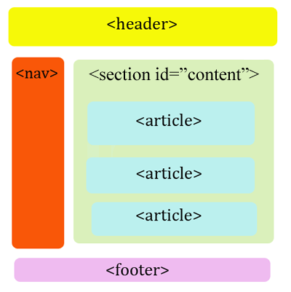
<DIV>
Live Demo
<DIV>

Slide 30
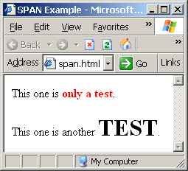
The <span> Tag
Inline style element
Useful for modifying a specific portion of text
Don't create a separate area (paragraph) in the document
Mainly used to style parts of a text
<p>This one is <span style="color:red; font-weight:bold">only a test</span>.</p>
<p>This one is another <span style="font-size:32px; font-weight:bold">TEST</span>.</p>

Slide 31


<SPAN>
Live Demo
<SPAN>some text</span>

Slide 32
Semantic Structural Tags

Slide 33
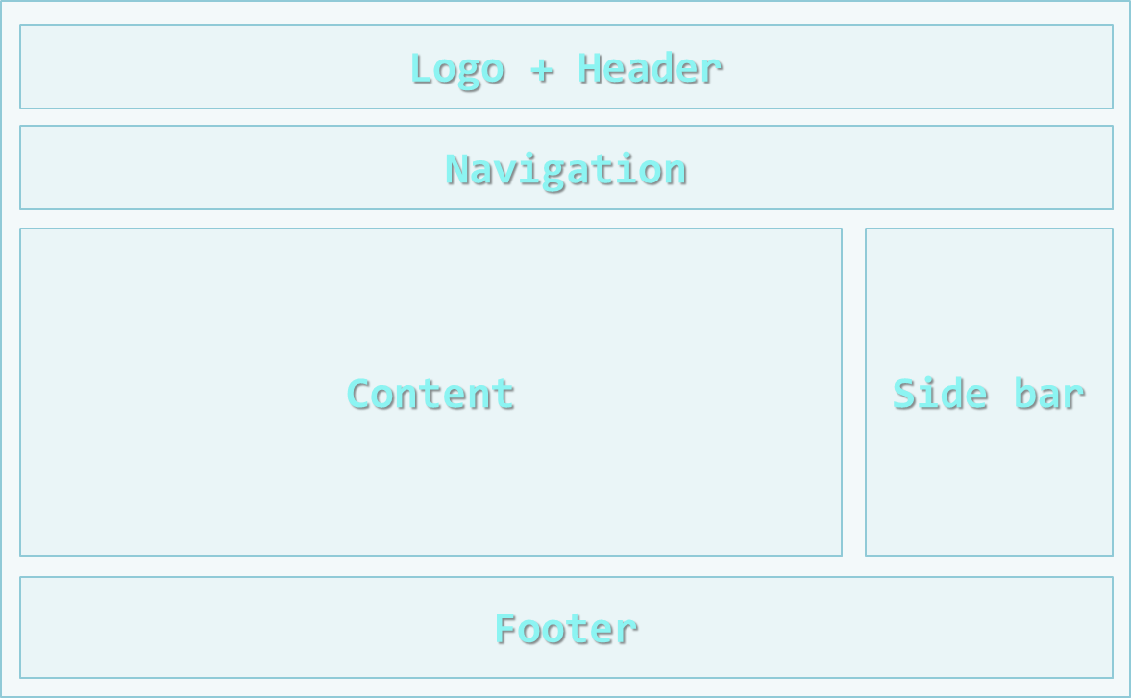
The Structure of a Web Page
A sample layout structure of a Web Page

Slide 34
The "HTML 4 and Before" Way
Using divs with IDs
The IDs are needed for styling
<html>
<head> … </head>
<body>
<div id="header"> … </div>
<div id="navigation"> … </div>
<div id="sidebar"> … </div>
<div id="content"> … </div>
<div id="footer"> … </div>
</body>
</html>

Slide 35
The HTML 4 Way
Live Demo

Slide 36
The HTML 5 Way
In HTML 5 there are semantic tags for layout
<nav>, <header>, <footer>, <section>
Work only on newer browsers
<html>
<head> … </head>
<body>
<header> … </header>
<nav> … </nav>
<aside> … </aside>
<section> … </section>
<footer> … </footer>
</body>
</html>

Slide 37

Semantic Structural Tags
Live Demo

Slide 38
Remember
It is important to have the correct vision and attitude towards HTML
HTML is only about structure, not appearance
Browsers tolerate invalid HTML code and parse errors – you should not
Always think about semantics
The W3C HTML Validator is a way to validate your HTML
http://validator.w3.org/

Slide 39
HTML 5
http://html5course.telerik.com

Slide 40
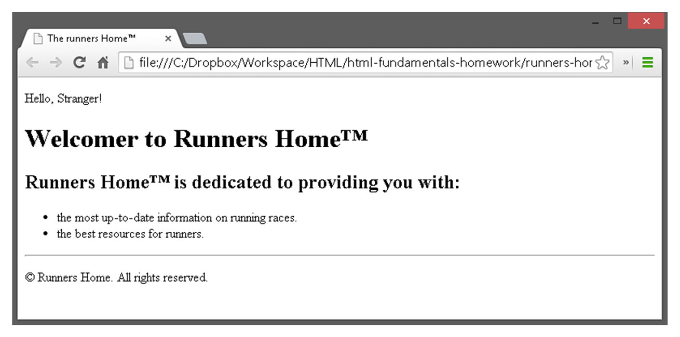
Exercises
Write an HTML page like the following:
* Use headings, divs, paragraphs and ul

Slide 41
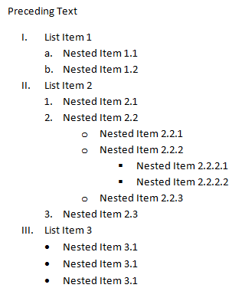
Exercises (2)
Write an HTML page like the following:

Slide 42
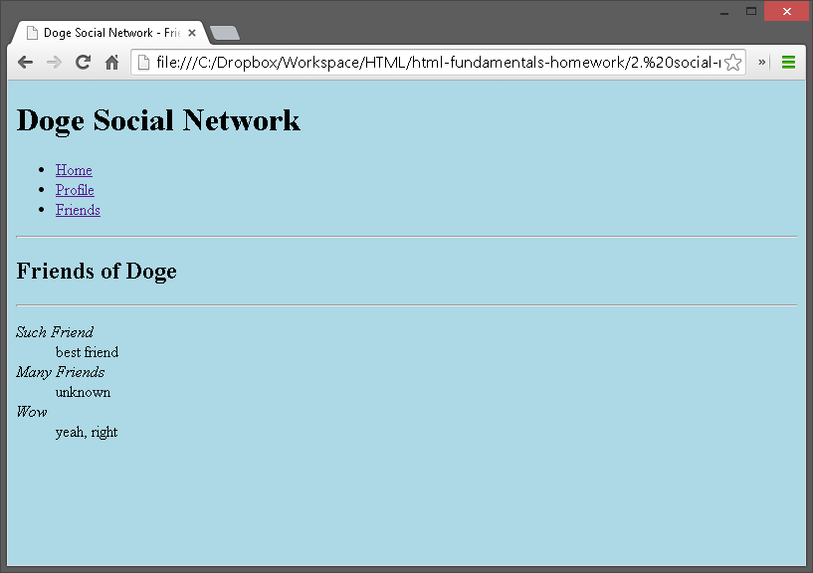
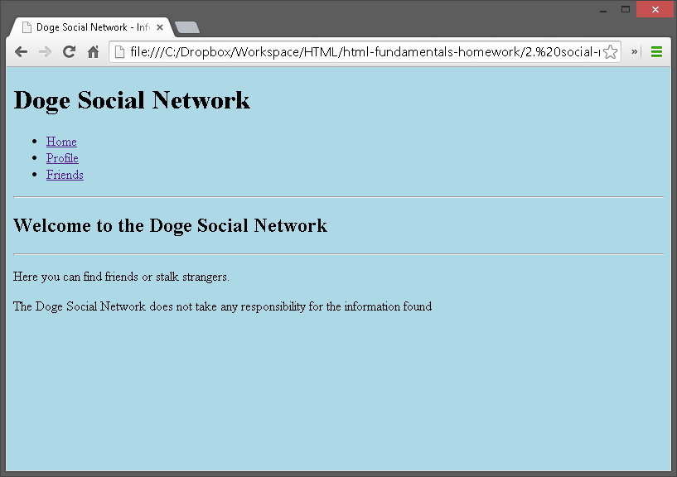
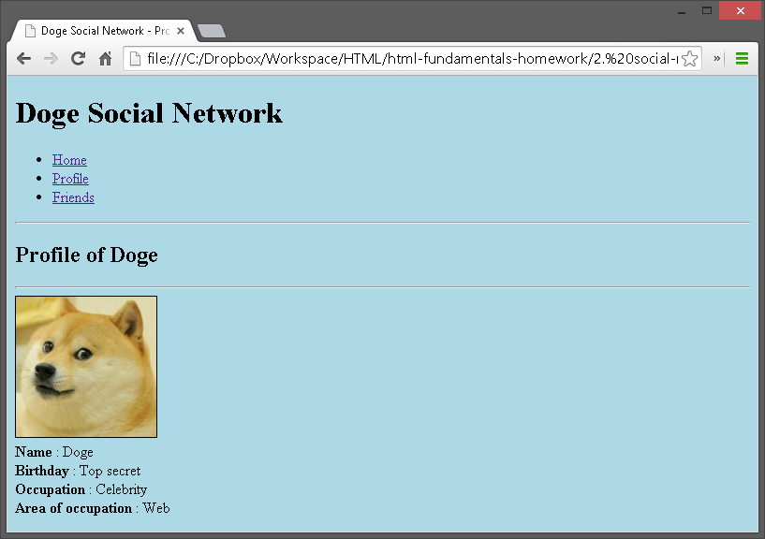
Exercises (3)
Create an user profile Web page profile.html, friends page named friends.html and info page named home.html. Link them to one another using <a> tag

